Slide 1
Who are You?
Individually (3 minutes)
Value Prompt (3 minutes)
Write your name LARGE
Add some drawings of your interests/hobbies/history/family
Decorate as you please (school appropriate)
Everyone chooses one prompt and makes brief notes:
A learning experience with classmates that made you feel supported/excluded
A group project that went well/poorly—and why
A time a classmate changed your mind about something important
What respect/disrespect looks like between students in college

Slide 2
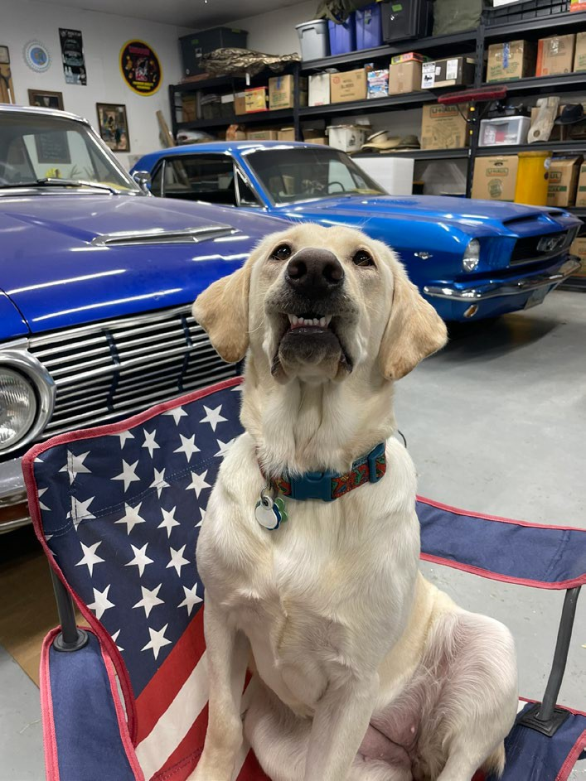
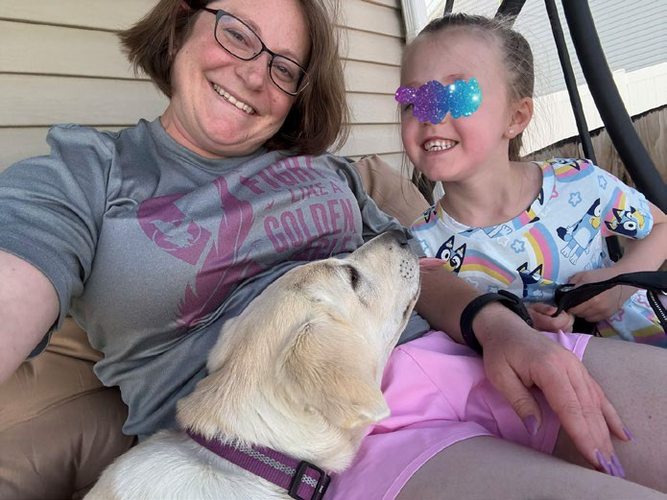
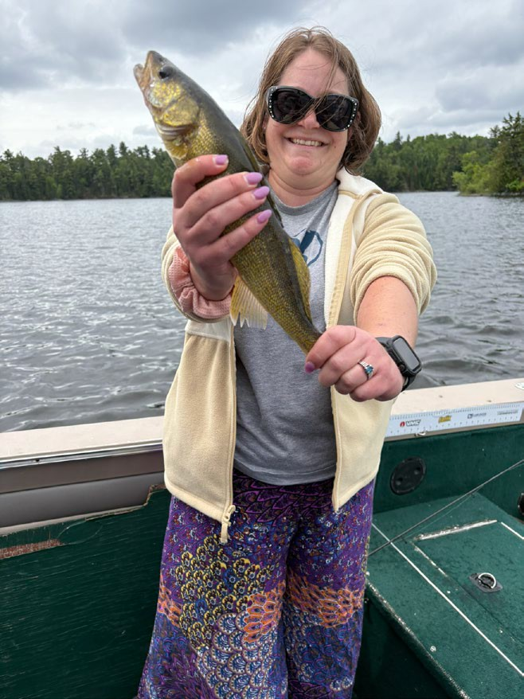
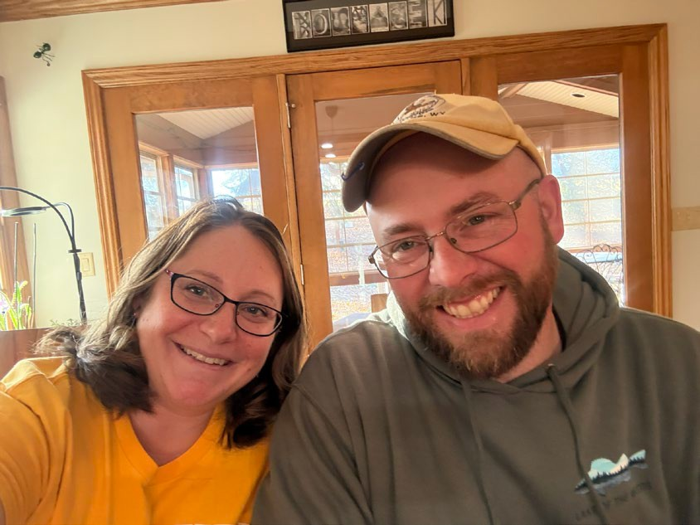
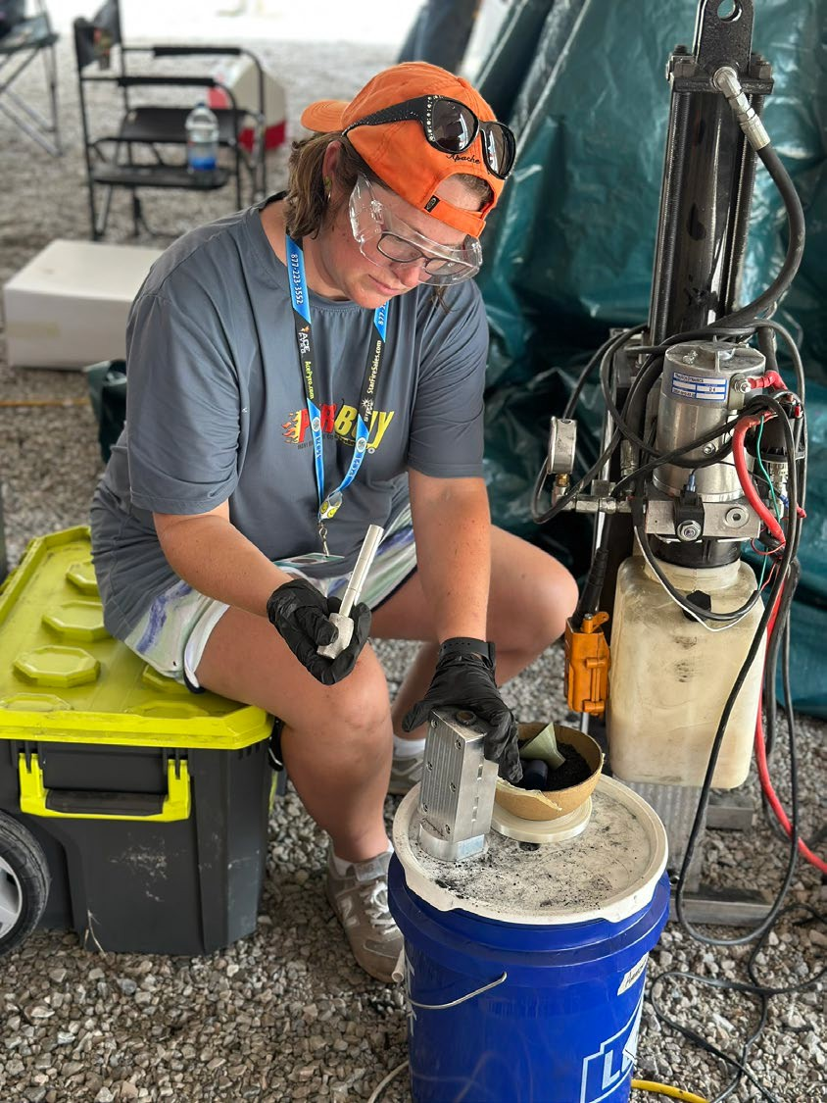
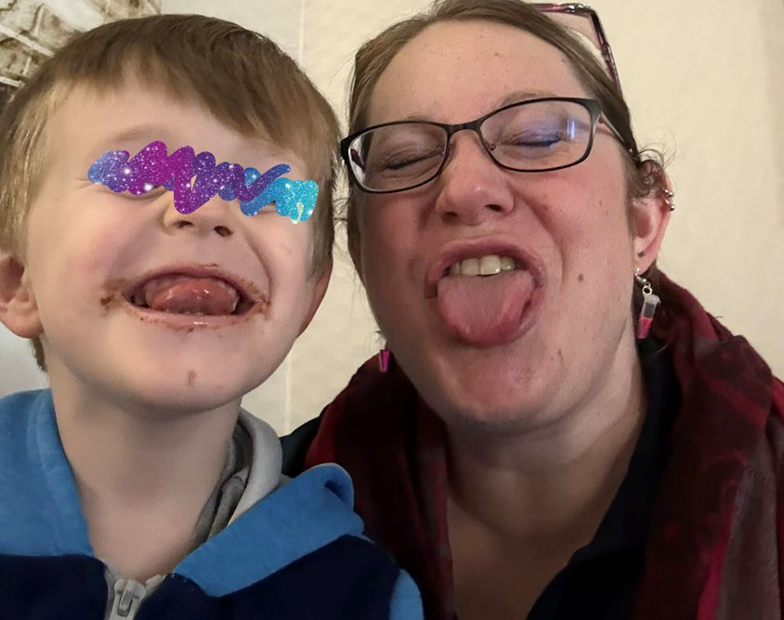
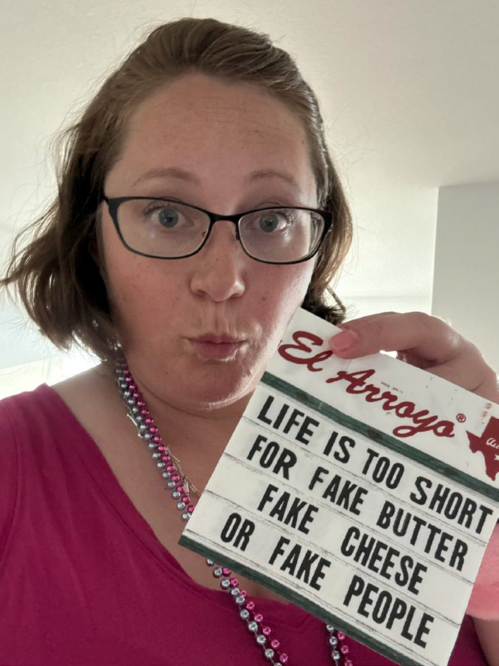
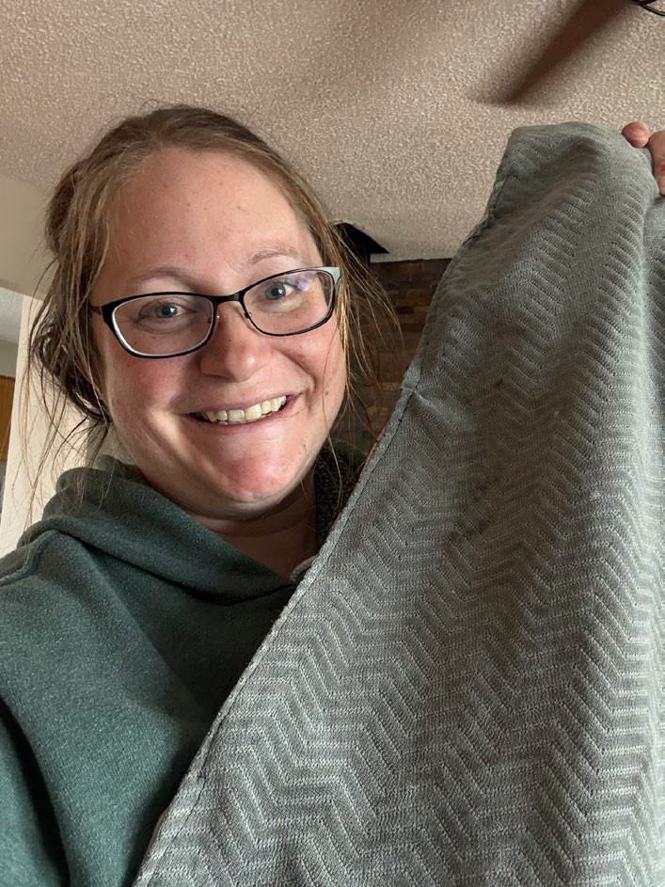
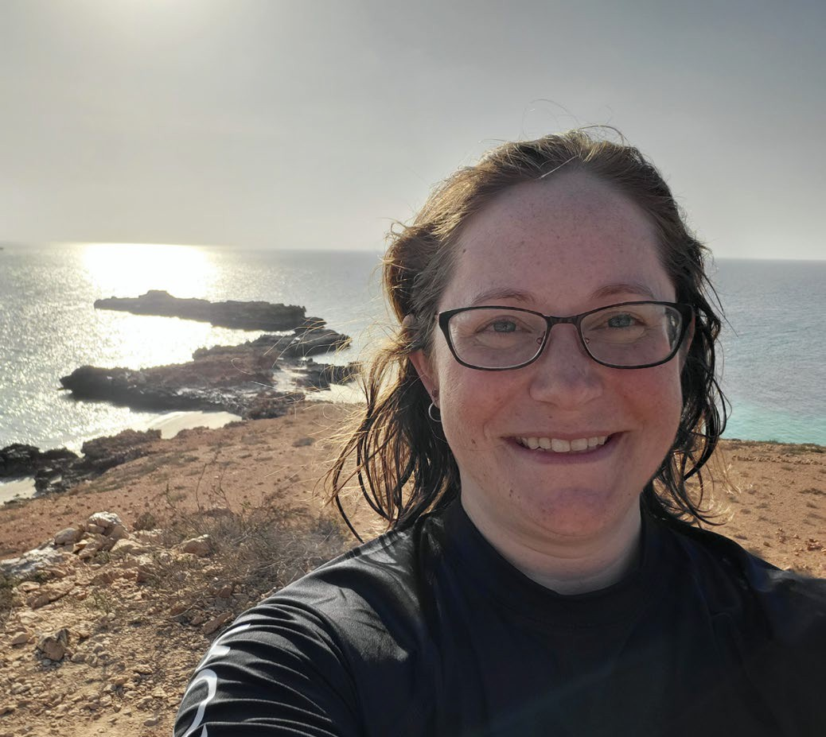
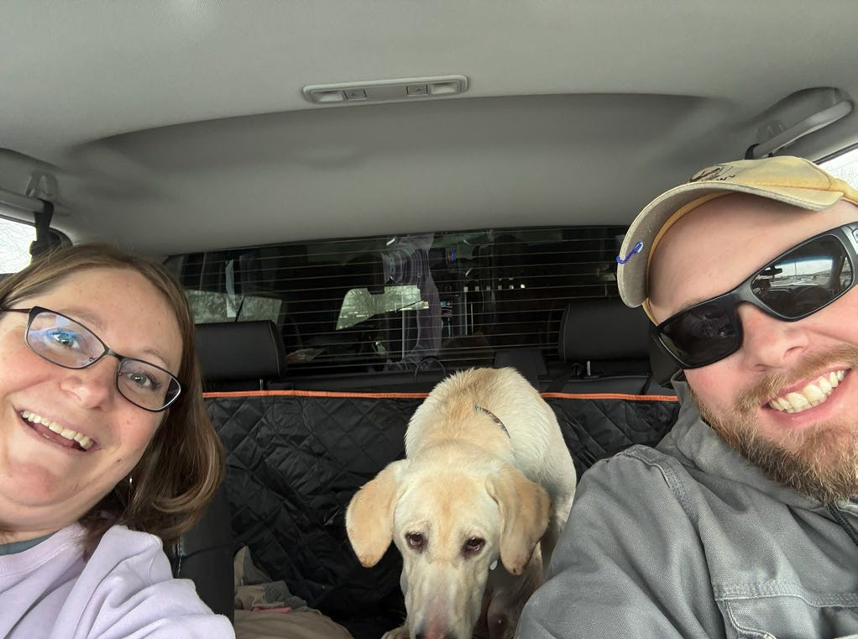
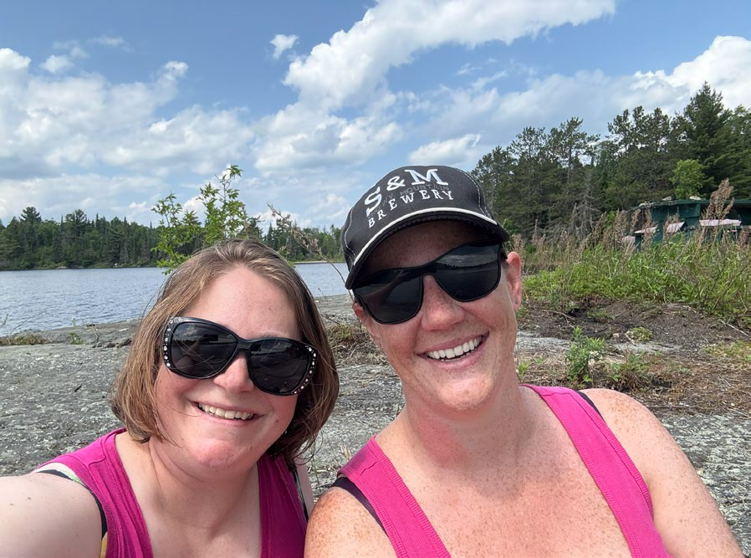
Dr. Talbott

Slide 3
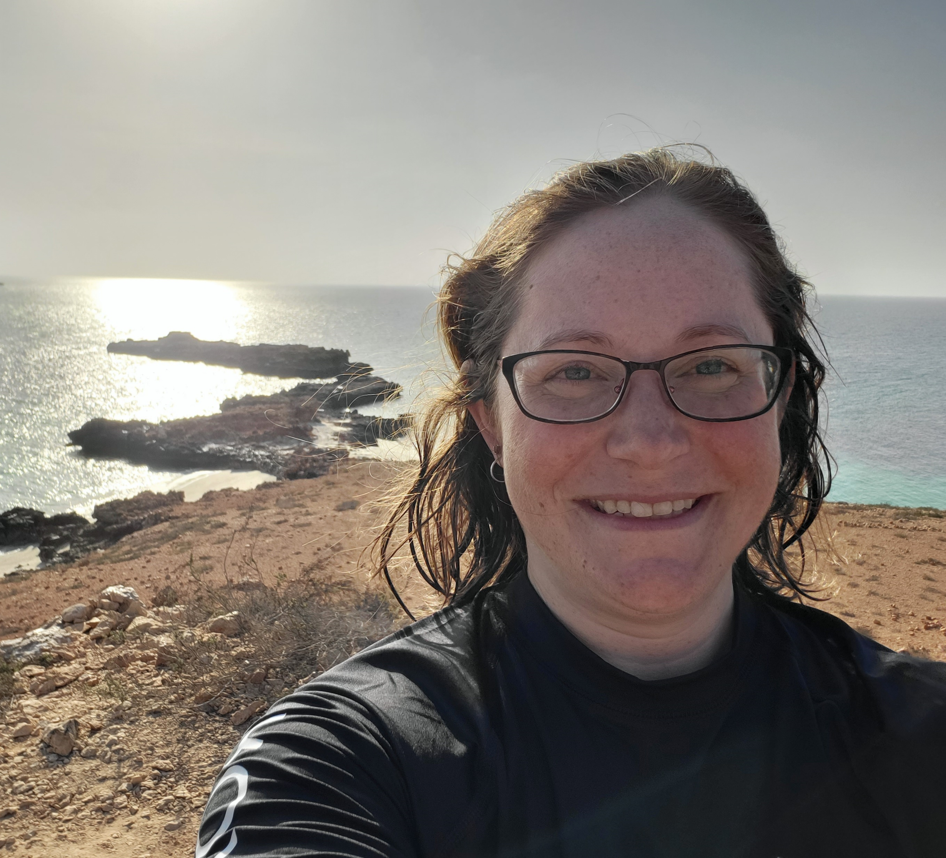
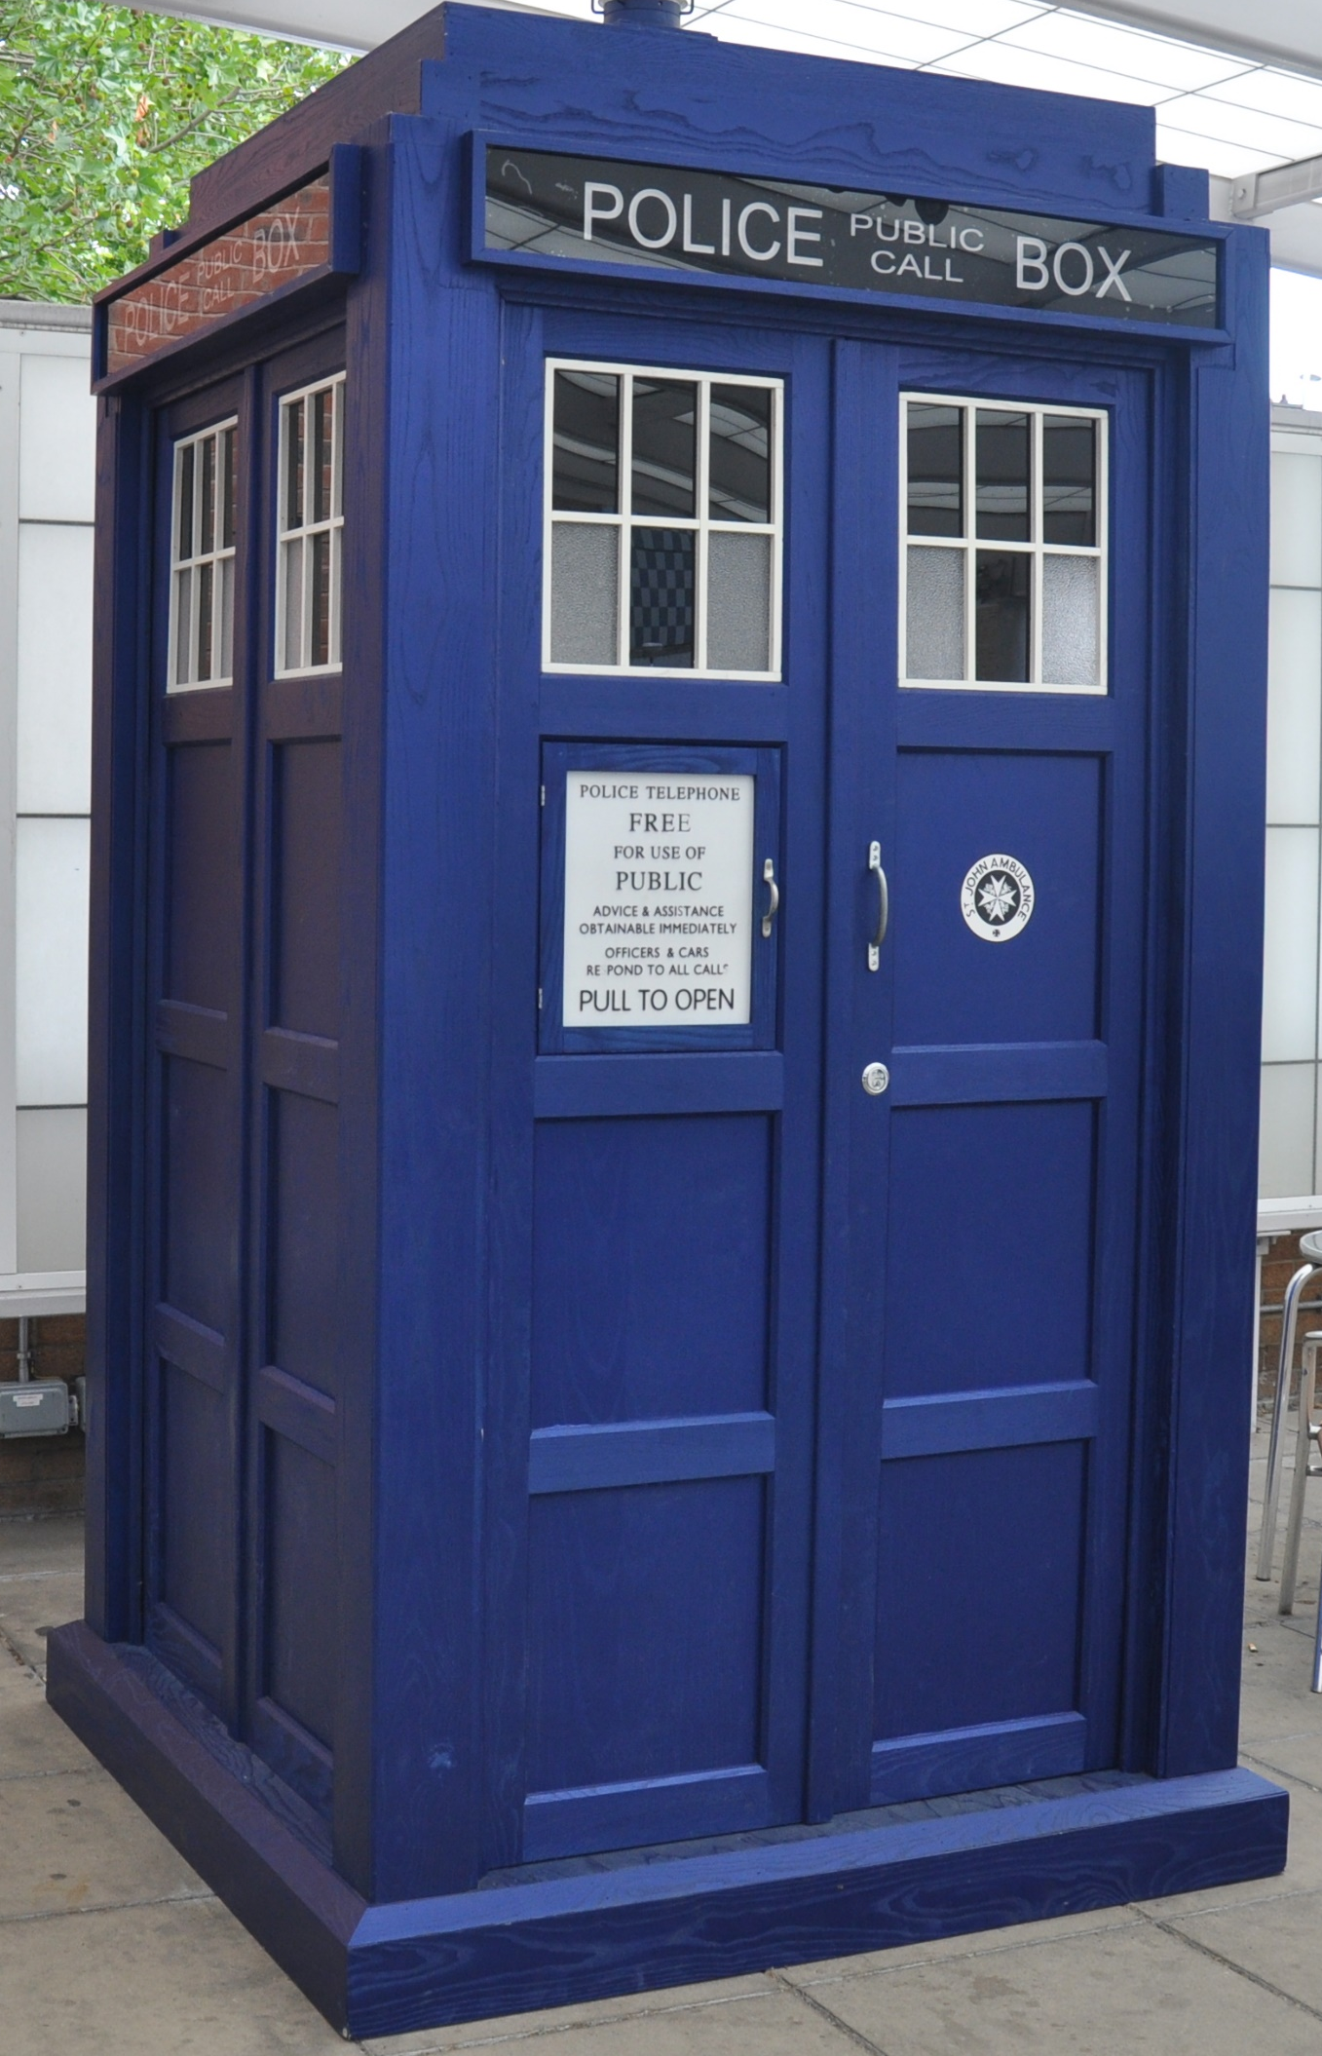
Dr. Talbott
University of Wyoming – Class of 2010
  B.S. Microbiology & Physiology
University of Nebraska Medical Center – Class of 2017
  Ph.D. Biochemistry and Molecular Biology
Oregon National Primate Research Center
  Research Scientist
Wyoming Department of Health
  Epidemiologist/Data Analyst
ESC

Slide 4
Classes Live and Recorded

Slide 5
Values & Listening Activity
Listening Round (3-5 minutes/student)
Reflect & Identify Values (3-5 minutes)
Speaker
Shares name and key info
Talks for 5 minutes about their prompt
Focuses on what mattered most to them and why
Listener
May not interrupt
Shows engagement using nonverbal cues (nodding, posture, eye contact)
Takes mental notes on values, not just facts
Each listener responds using this structure:
“What I heard you value most is ___ because ___.
Speaker confirms or clarifies
Listener may ask one curiosity-based question, such as:
  “What shaped that value for you?”
  “How does that show up in how you work with others?”

Slide 6
Who are you as a group?
Finding Shared Group Values (10 min)
Create Your Group Name (5 min)
As a group, discuss:
“What values do we seem to share?”
Aim to find 2-3 group values you agree represent your values as a group
Use your shared values to create a group name that reflects your identity and values as a group.
Your name should reflect:
  Who you are as a group
  How you want to work together

Slide 7
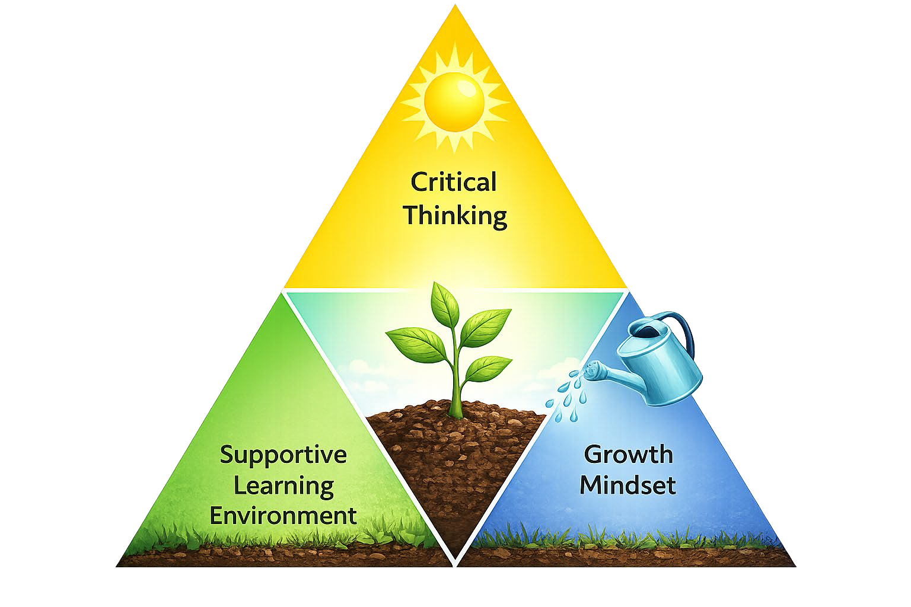
Teaching Philosophy
“If a [student] can't learn the way we teach, maybe we should teach the way they learn” -Ignacio Estrada
My goal is to focus on teaching the way you learn and empowering each of you to reach your maximum potential.

Slide 8

My Values
Communicate
Self Responsibility
Be Curious
https://www.teachwithmrst.com/post/teacher-expectations-can-affect-pupil-outcomes

Slide 9

Your Expectations of Me

Slide 10
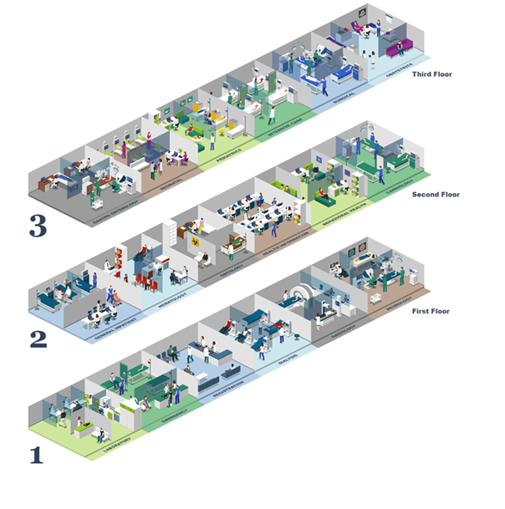
Logistics and Layout
My Office – PF210A
Restrooms
Water Fountains
AED
Notes:
https://icograms.com/templates/472/layout-of-the-hospital

Slide 11


Course Goals
Language
  Translate medical terminology into common language and vice versa.
  What do we call it?
Notes:
https://commons.wikimedia.org/wiki/File:Translate.png

Slide 12
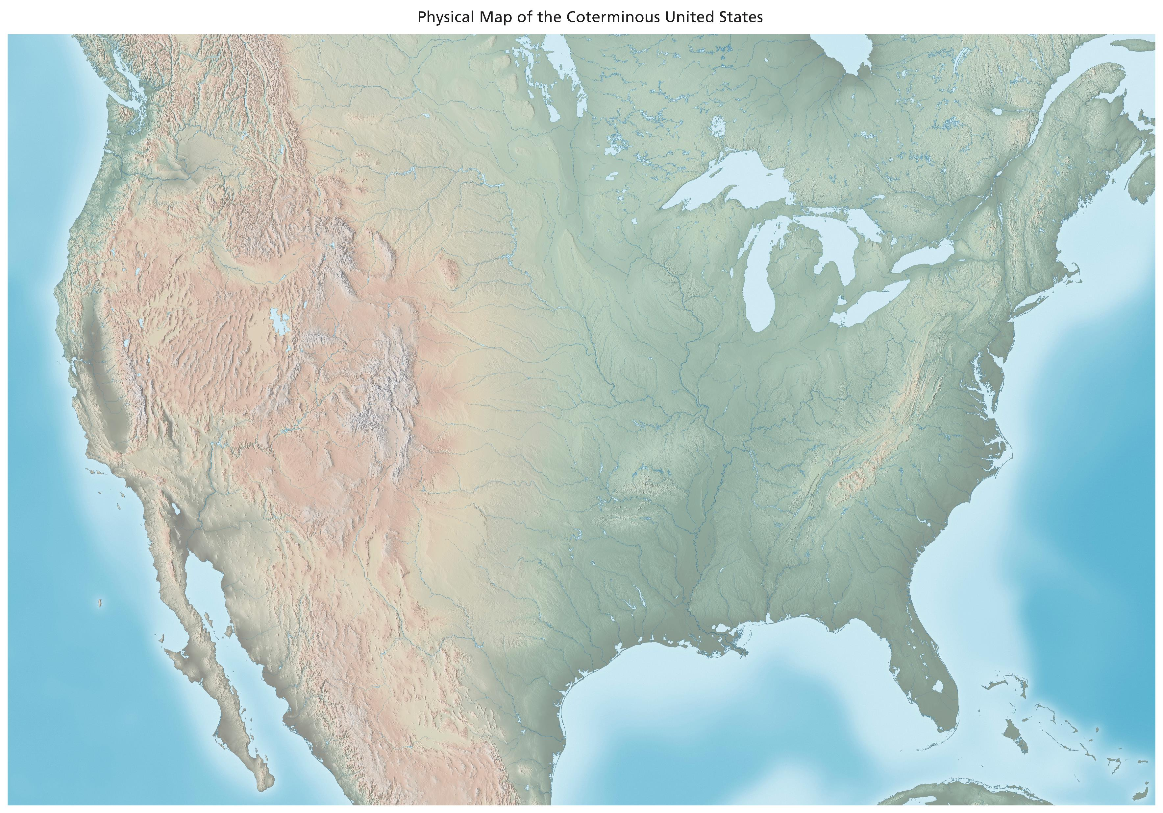
Course Goals
Geography
  Locate and describe major cell types, tissue types, and organs of the human body.
  Where is it?
  What does it look like?
http://www.shadedrelief.com/physical/pages/download.html
Notes:
http://www.shadedrelief.com/physical/pages/download.html

Slide 13

Course Trigger Warnings
This course includes materials and discussions that will be uncomfortable or emotionally challenging
Graphic Content: Cadavers, dissections, and internal organs
Sensory disturbances: Smells, textures, visual, and/or auditory experiences that may be unsettling
Blood & Trauma: Injuries, surgeries, and bodily fluids
Life and Death Topics: Birth, reproduction, death, and dying
Emotional Sensitivities: Medical conditions (including cancer,) self-harm, or abuse
Ethical Discussions: Organ donation, euthanasia, dissection of animals
If concerned or affected: You are encouraged to step out, care for yourself, and reach out to me or campus resources for support.

Slide 14
Contacting Dr. Talbott
Please reach out at any time if you have a question or need help.
Contact:
  Message me on Canvas
  Email me at htalbott@lccc.wy.edu
  Text me
  Chat with me on Teams
  Call me on Teams
  Call 307-778-1315
  Schedule a Meeting: Navigate or Calendly

Slide 15

Course Materials
Lab Manual (REQUIRED, eBook not recommended): Laboratory Manual For Principles Of Anatomy And Physiology (Looseleaf)

Slide 16

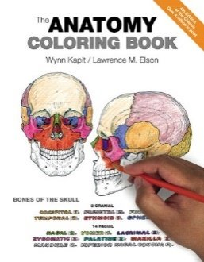
Course Materials
Optional Textbook (optional): Anatomy and Physiology
Other (optional): Anatomy Coloring Book
Recommended: one (1) 3-inch binder for the textbook one (1) 1.5-inch binder for the lab manual two (2) 0.5-inch binders for using only the unit/module materials

Slide 17
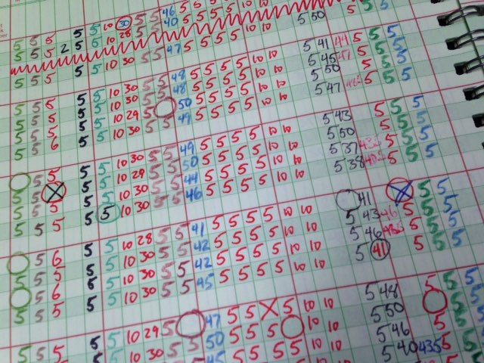
Grading
Lecture Component (60%)
  Quizzes (7 quizzes): 45%
  IDK Research Presentation: 10%
  Art Project: 5%
Lab Component (40%)
  Lab Practical Quizzes (3 quizzes): 20%
  Lab Assignments and Reports: 20%
This Photo by Unknown Author is licensed under CC BY-SA-NC

Slide 18
Other Projects
IDK Research Presentation
Final Art Project
The objective is to practice your research and communication skills effectively.
Individual or group (max 4)
5-10 min of content per student
Students will create an art piece related to an anatomical structure or system using any medium (clay, yarn, edible goods, painting, computer animation, etc.) and present their creations in a gallery walk.

Slide 19
Lab Practical Quizzes
Quizzes are cumulative and comprehensive
A non-collaborative and timed quiz.
Identify structures on models, specimens, or slides in a timed, station-based format.
Allowed resources: you and your brain
Not allowed resources: books, notes, other people, and online resources
Quizzes are taken in class. It can be made up within a week if an excused absence.

Slide 20

Extra Credit Bingo
Get your Bingo card: Each square has a task designed to help you engage with the course and enhance your learning. Trading is allowed in class on the first day.
Complete tasks to make Bingos:
  A Bingo is a straight line of 4 completed tasks (horizontal, vertical, or diagonal).
Document your progress: For each completed task in a Bingo, briefly describe what you did and submit any required proof (e.g., a photo, reflection, or confirmation from a peer or instructor) within this assignment.
Aim for a blackout: Complete all 16 tasks on the card to earn the maximum extra credit.
Each Bingo: 5 points ( 0.5% of final grade)
Blackout: 50 points (5% of final grade).

Slide 21

Attendance
You will receive points for many in-class activities
Excused absence in this class requires that you communicate with me in advance, if possible, or as soon as possible
Unexcused absences from class will not be able to make up in-class assignments and points

Slide 22
AI and Learning

Slide 23

IDK points
You encouraged to ask questions, in class, after class, out loud, on paper, by email
If I don’t know the answer to your question the class gets 1 IDK point
If the whole class can reach 20 IDK points I will bring a treat for the whole class (donuts/cookies/pizza/etc)
Questions must be relevant to class

Slide 24

Lab Safety

Slide 25


Podium

Slide 26
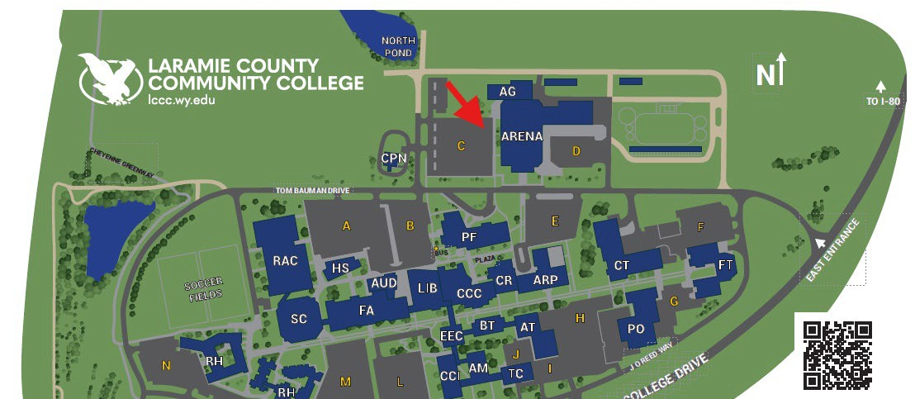
Evacuation Muster Spot

Slide 27
Creation and Copyright Information
Last updated: 2026/8/24 By: Heather Talbott
This work is licensed under Creative Commons Attribution-NonCommercial-ShareAlike 4.0 International License: CC BY-NC-SA 4.0
This content was drafted and/or edited with the following tools and has been thoroughly revised and reviewed for accuracy:
OpenAI. (2026). ChatGPT (GPT-5) [Large language model]. https://chat.openai.com/Links to an external site.
Microsoft. (2026) Copilot (GPT-4) [Large language model]. https://copilot.microsoft.com/.
Grammarly. (2026). Grammarly (Version 14.1268.0) [Software]. https://www.grammarly.com/

